Slide 1
DFI Project Update 3 Downtown Opportunity Site & Phase 1 Predevelopment
Salisbury, NC

Slide 2
Agenda
Project Overview
Market Analysis
Office
Retail
Multifamily
Hospitality
Next Steps

Slide 3
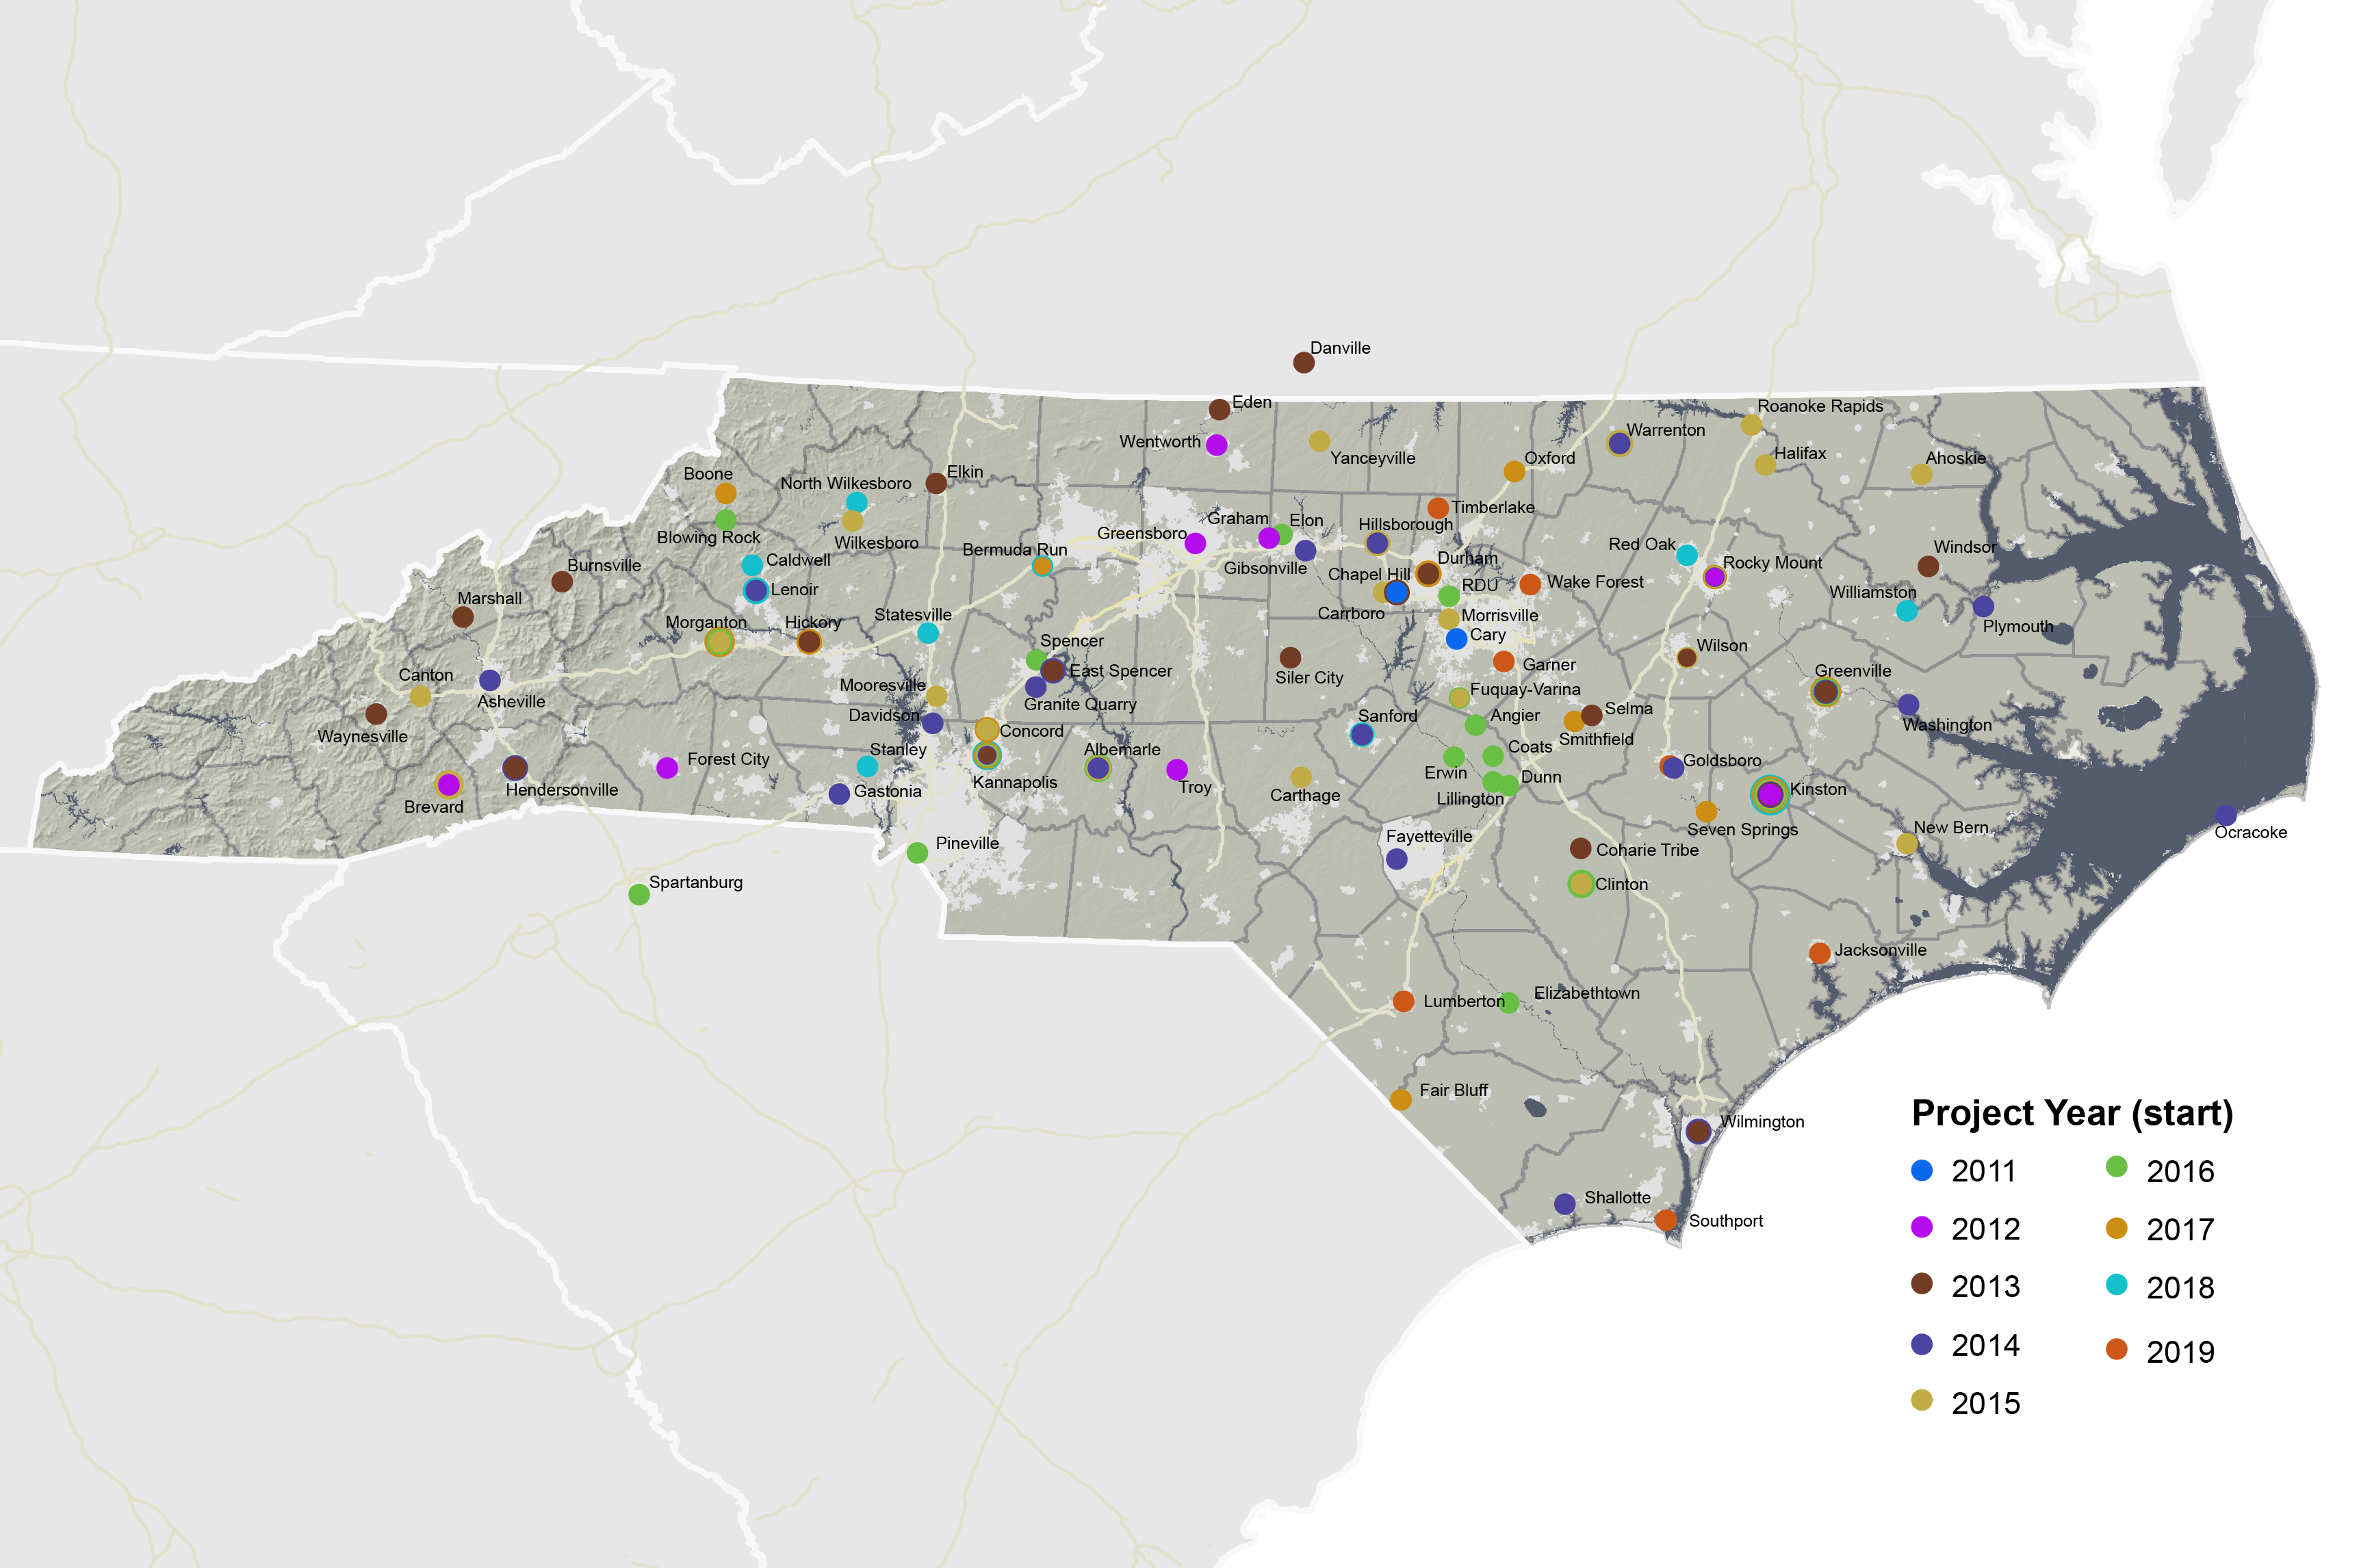
Development Finance Initiative
The Development Finance Initiative (DFI) is a program of UNC Chapel Hill’s School of Government and collaborates with communities in NC to attract private investment for transformative projects by providing specialized finance and real estate development expertise.

Slide 4
DFI Engagement
In January 2020, the City of Salisbury engaged DFI to provide two types of technical assistance concurrently. The scope of work includes:
Opportunity Site Identification services focused on downtown Salisbury
Phase 1 Pre-Development assistance for two City-owned sites in residential areas adjacent to downtown

Slide 5
DFI Pre-Development Process
Feasible Project
Site
Analysis
Public
Interests
Market
Analysis
Financial
Analysis

Slide 6
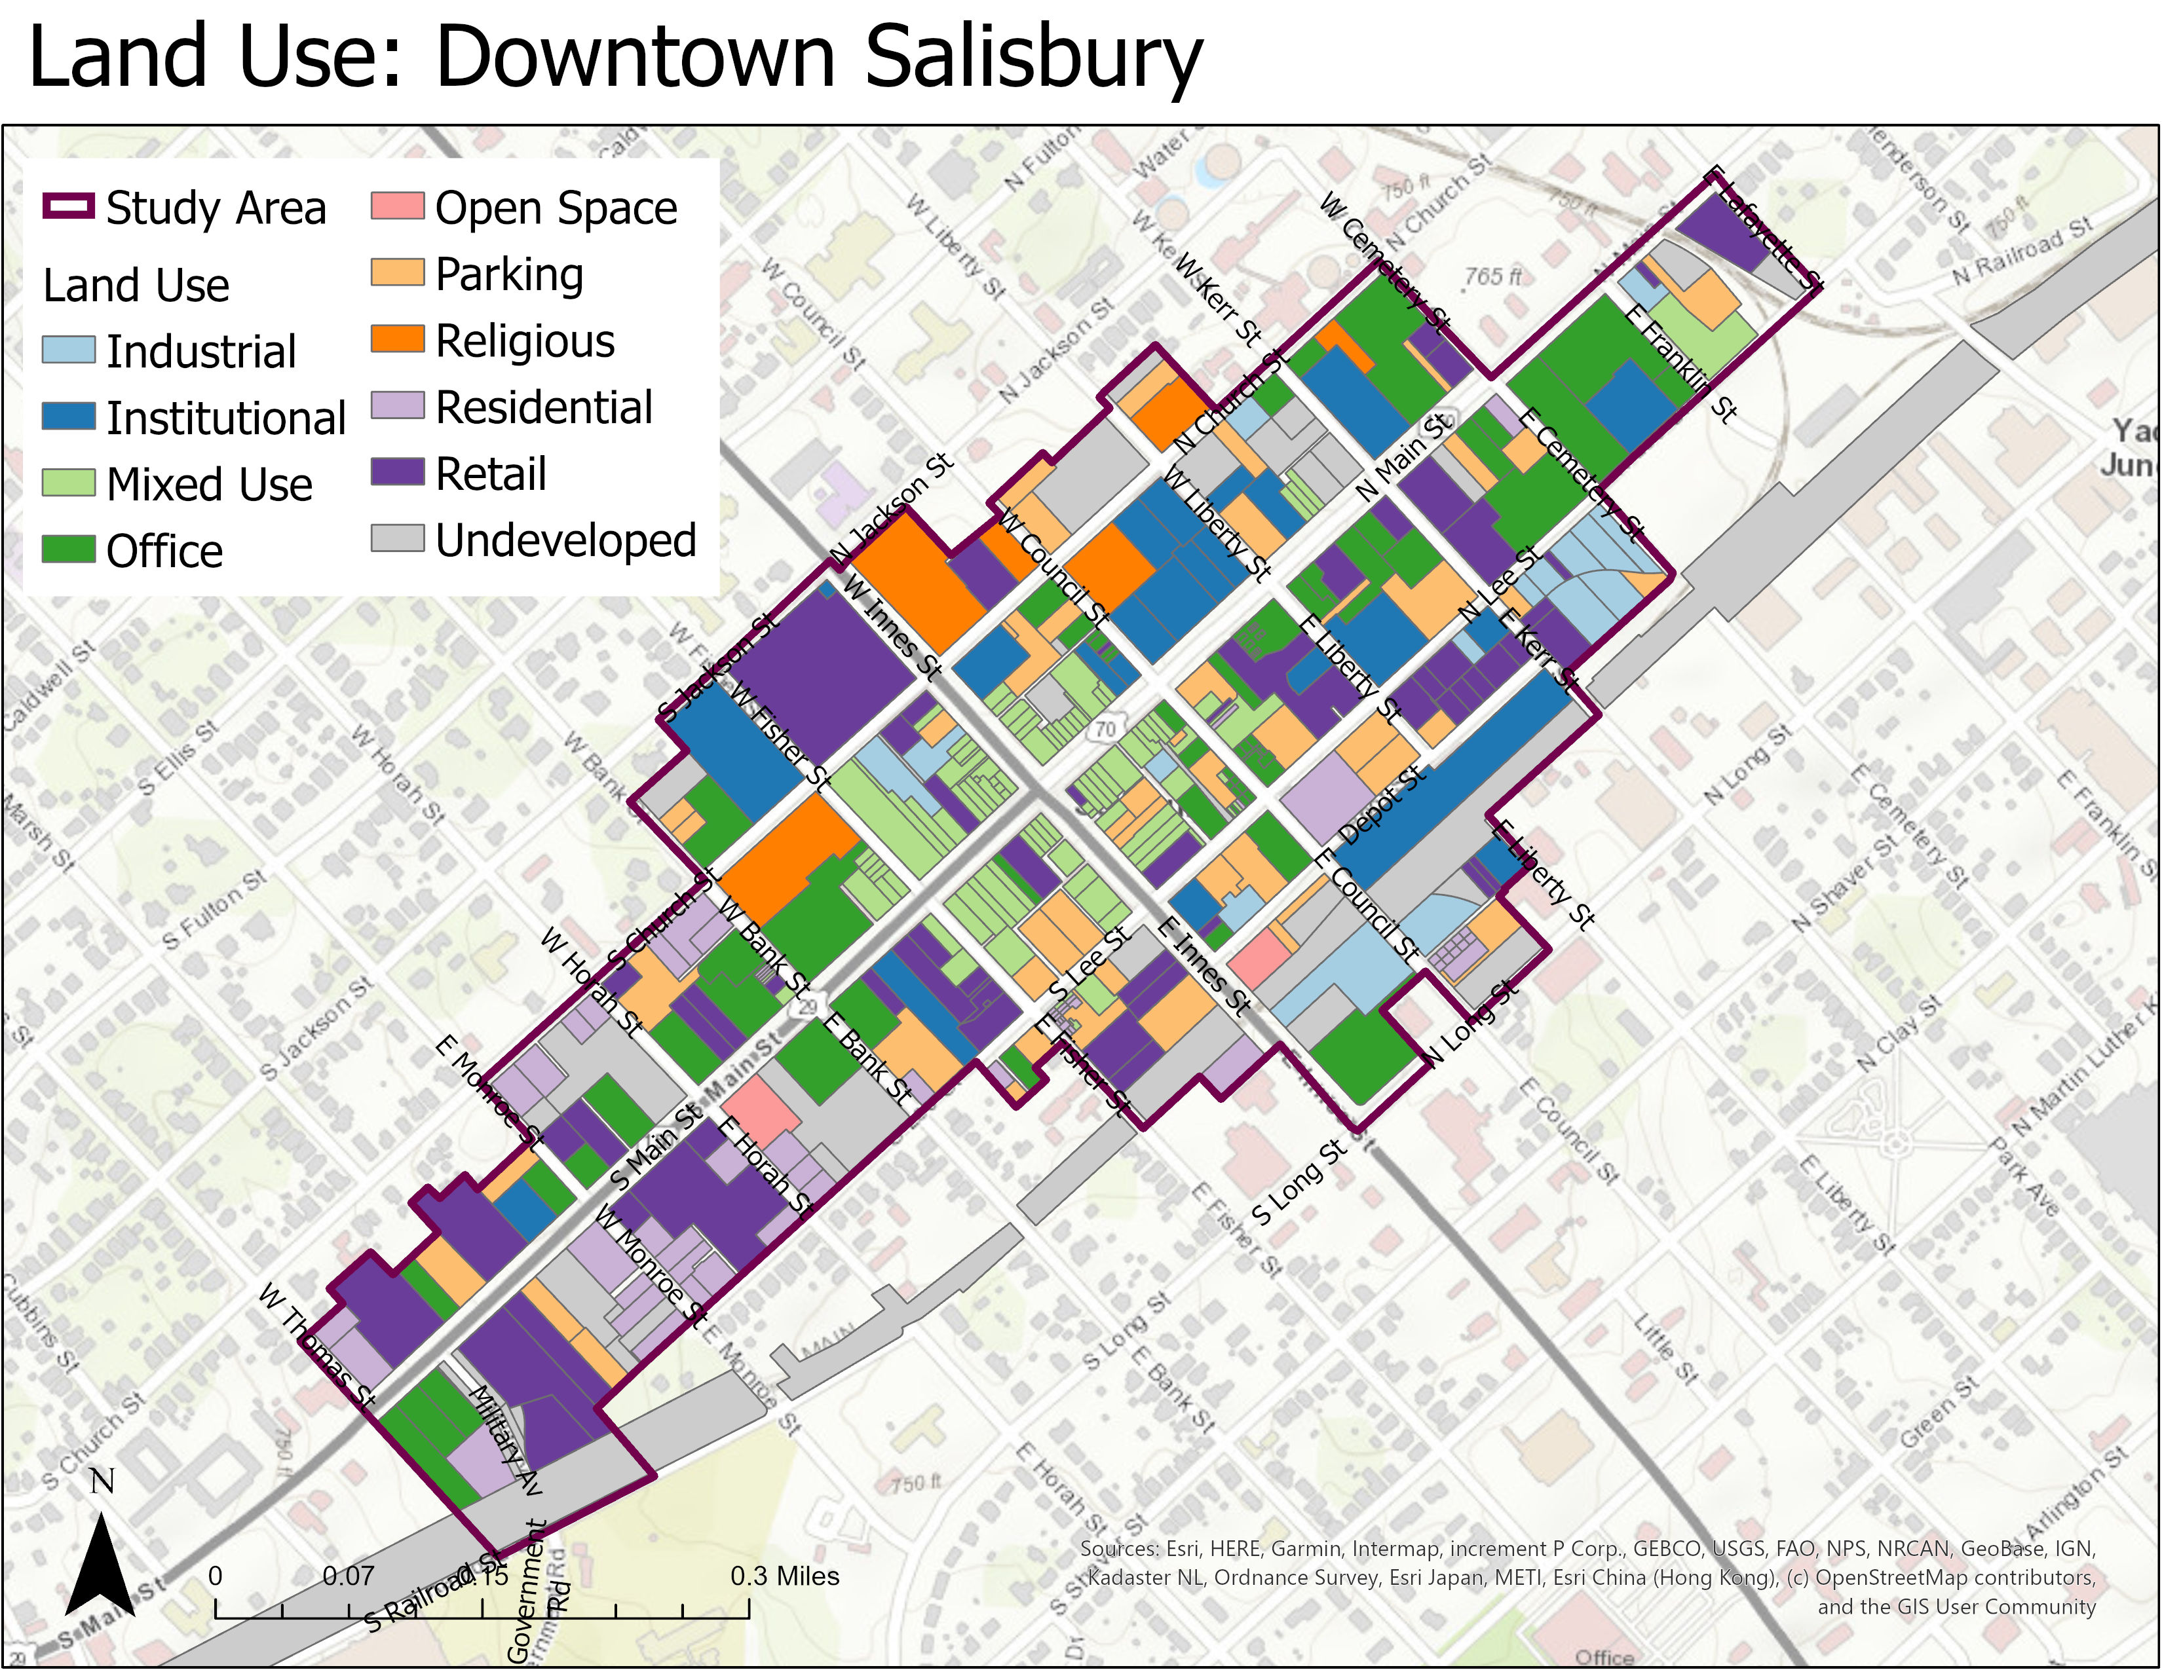
Opportunity Site ID: Downtown Salisbury
SOURCES: Google Earth, ESRI

Slide 7
Project Timeline
Kick-Off
Mar 9
Update #2
May 22
Update #3
Sep 1
Final Update
Nov 3
*
*Phase 1 Predevelopment only
Note: Timeline subject to change based on type and scale of public interest process.

Slide 8
Market Analysis

Slide 9
Market Analysis Process
DFI studied the existing conditions in downtown Salisbury and analyzed key market indicators to understand demand for office, retail, market-rate multifamily housing, and hospitality development.
Each market feasibility analysis by use includes:
Definition of market/trade area
Analysis of current market conditions
Analysis of demand drivers
Estimates of future growth based on projections of historic trends and downtown capture rates

Slide 10
Adjustments for COVID-19
In addition to studying existing conditions utilizing 2019 census data, DFI incorporated the following into our analysis to account for the impact of COVID-19 on the market analysis:
Qualitative Data Collection
DFI engaged with various stakeholders and local RE brokers to understand market impacts in ‘real-time’
Market assumptions
DFI will adjust certain assumptions in our COVID market analysis models to account for COVID impacts. Factors considered include: vacancy rate, SF per employee, rents, occupancy rate, etc.
This presentation will show market conditions pre-COVID 19.
DFI will provide additional analysis to account for COVID-19 impacts

Slide 11
Office

Slide 12
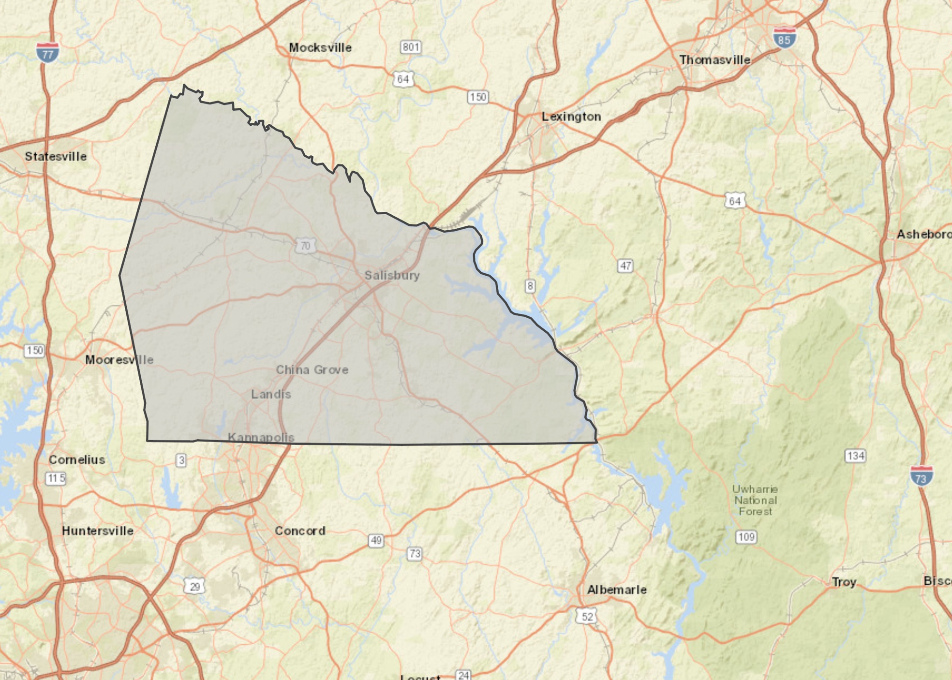
Salisbury Office Market Area
1.2K
896K
Total Businesses
Total Square Feet Class B*
7.3K
3%
Total Employees
Vacancy Rate Class B
$48K
$15.21
Median HH Income
Median Rent Per Square Foot Class B
* No Class A in Rowan County SOURCES: CoStar, ESRI

Slide 13
Slow Office Delivery in Market Area
Salisbury Business Center
404 N Main St.
China Grove, NC
SOURCES: CoStar

Slide 14
Vacancy and Rents have Decreased Over Time
No Class A Office Inventory in Market Area
SOURCES: CoStar

Slide 15
Downtown Office Demand
Office Demand over next 5 years
Current demand @ stable vacancy* (SF) | 40K
Projected new demand by 2024** (SF) | 53K - 79K
Total Office Demand in Market Area (SF) | 93K – 119K
Total Office Demand in Downtown Salisbury*** | 36K – 47K
Large Vacant Office Buildings
Former Wells Fargo Building (SF) | 22.5K
Salisbury Post (SF) | 56K
*Office market constrained at <3% vacancy. A stable vacancy is roughly 7%.
**Based on an estimated 1,100 new office-prone jobs in market area by 2024; assumes 150-250 sf of office per worker.
***Based on a historical capture rate of 40%
SOURCES: ESRI, NC Department of Commerce

Slide 16
COVID-19 Impact on Office
Amount of sublease space has increased over 30% from same time last year. (CoStar)
Leasing has dropped 56% from same time last year (CoStar)
Remote workforce directives, rise of video conferencing software have driven lack of demand for office spaces
Businesses that do return to offices will operate at lower office worker density (more space per employee)
Older, cheaper space may not be as attractive to tenants who don’t want to sacrifice health and safety standards that newer buildings may have. (Cushman Wakefield)
Smaller office buildings may be more attractive to tenants (less interaction amongst other businesses, less need for elevators and other high touch areas) (Cushman Wakefield)
A worst-case scenario would equate to a 50-60% reduction in office space demanded in Salisbury over the next five years. (CoStar, DFI Analysis)
SOURCES: CoStar, DFI Interviews and Analysis, Cushman Wakefield

Slide 17
Office Market Summary
Low vacancy and rents suggest older office product in the market.
Potential office demand in downtown Salisbury pre-COVID is 36K – 47K over the next five years.
Recent vacancy, coupled with low rents, may make it difficult to develop new office in downtown.
Uncertainty surrounds the impacts of COVID-19 on future office demand.
Worst case scenario shows a 50 – 60% reduction in office space demanded over the next five years.
SOURCES: CoStar, ESRI, DFI Interviews and Analysis

Slide 18
Retail

Slide 19
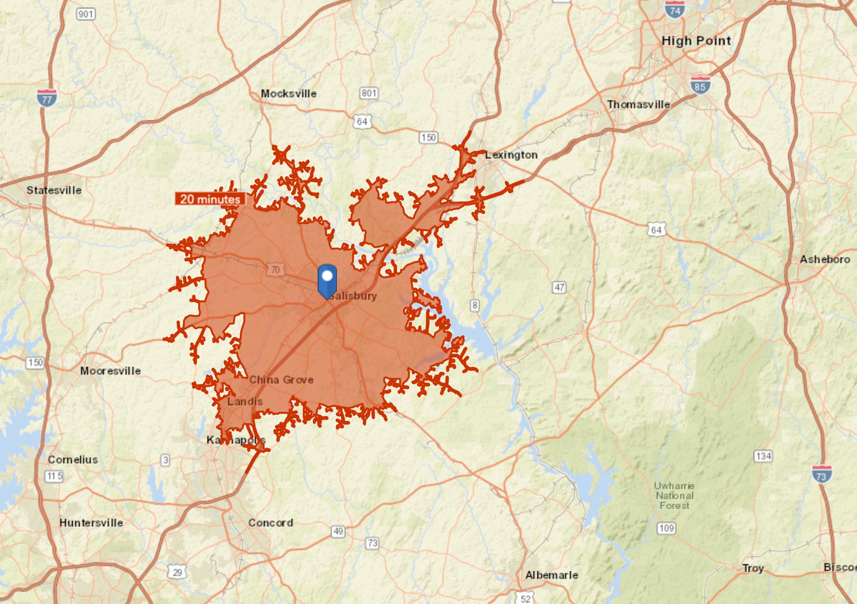
Salisbury Retail Trade Area
166K
7.5M
Daytime Population
Total Square Feet
41% are workers
67K
3%
Total Households
Vacancy Rate
Class A & B
<1% increase per year
$7,725
$14.71
Per Capita Sales
Average Rent PSF
Class A & B
Downtown Salisbury: $11 - $14
Based on trade area population
SOURCES: CoStar, ESRI

Slide 20
Declining Vacancy, Modest Rent Growth
Occupancy, Vacancy, and Rents for Class A & B Properties
SOURCES: CoStar

Slide 21
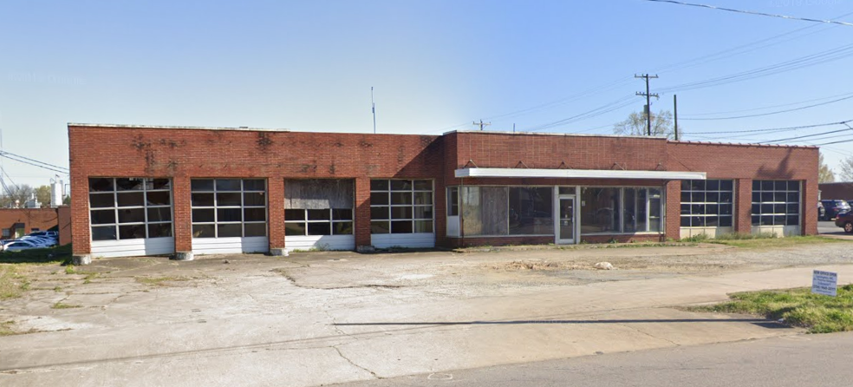
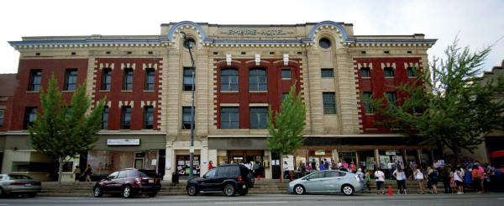
Retail Supply In the Pipeline
403 N MAIN ST – 5500 SF
Retail Proposed or Under Construction
20,400 SF
Rowan, Davidson County Retail Supply in Pipeline
+
33,900 SF
Salisbury Downtown
Retail Supply in Pipeline
EMPIRE HOTEL
54,300 SF
Total Retail Pipeline SF
EMPIRE HOTEL – 28.5K SF
SOURCES: CoStar, DFI Interviews and Analysis

Slide 22
Low Retail Demand in Downtown Salisbury
Retail Demand over next 5 years
Current demand @ stable vacancy* (SF) | 30K – 35K
Projected new demand by 2024** (SF) | 177K – 265K
Total Retail Demand in Market Area*** (SF) | 152K – 245K
Total Retail Demand in Downtown Salisbury**** | 4,500 – 7,200
*Retail market constrained at <3% vacancy. A stable vacancy is roughly 7%.
**Based on an estimated 69K new households in market area by 2024; assumes 150-250 sf of retail sf per customer.
***Is the sum of current demand plus projected demand minus pipeline supply ****Based on a 3% historical capture rate
SOURCES: ESRI, NC Department of Commerce

Slide 23
COVID-19 Impact on Retail
Retail visits fell by 50% in April of 2020 and have plateaued at 25% less of pre-pandemic visits in recent months. (CoStar)
Accommodations and Food Services and Beverage are the most affected businesses (McKinsey)
As of July 2020, Salisbury received 52 loans from the Paycheck Protection Program. Limited-service restaurant recipients include:
Team Carolinas Inc $2-5M (6 jobs)
Jaar Company LLC $1-2M (291 jobs)
Cook Out Salisbury Inc $150-350K (29 jobs)
Rowan county projecting a 4% reduction in downtown supportable sales
may equate to and additional ~10K SF of retail space demanded in downtown Salisbury over the next five years
SOURCES: Opportunity Insights, ProPublica, DFI Interviews and Analysis, CoStar, McKinsey

Slide 24
Retail Trade Area Summary
Though vacancy has declined since 2010 (9% → 3%), rent growth has been modest over the same time period (5%).
The Empire Hotel will have a significant impact on retail demand in the trade area (adds 28K SF of retail)
Potential retail demand in downtown Salisbury is 4,500 – 7,200 SF over the next five years.
Low retail rents ($12.50) pose a challenge for new development.
A reduction in downtown supportable sales may increase demand for retail in downtown Salisbury by ~10K SF over the next five years.

Slide 25
Multifamily

Slide 26
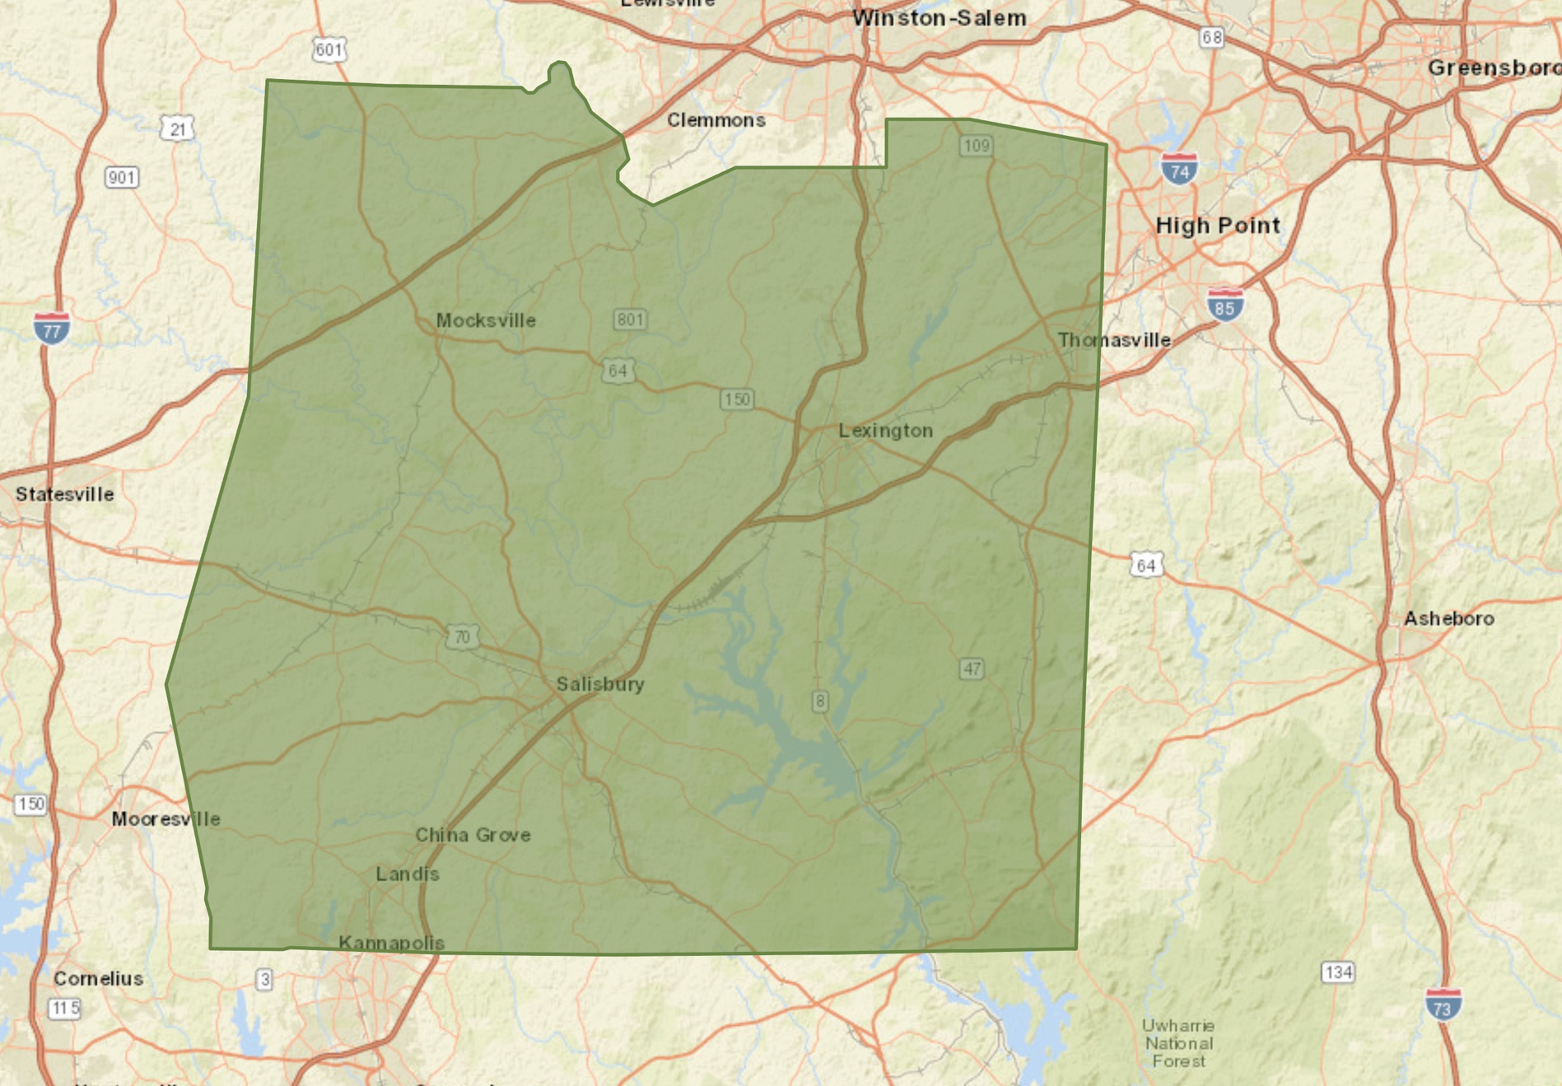
Salisbury Multi-Family Market Area
363K
2.8K
Total Population
Total Units
2019: 363K → 2024: 375K
<1% increase per year
Class B
141K
5%
Total Households
Vacancy Rate
2019: 141K → 2025: 145K
<1% increase per year
Class B; 2019
$50K
$0.85
Median HH Income
Average Asking Rent PSF
2019: 50K → 2024: $55K 2% increase per year
$1.21 in Downtown Salisbury
SOURCES: CoStar, ESRI, DSI Economic Vitality Committee

Slide 27
Multifamily Delivery in the Market Area
Brenner Crossing
+90
Gold Hill +80
132 E Innes +4
SOURCES: CoStar

Slide 28
Multifamily Market Demand
Multifamily Demand over next 5 years
2024 Projected Total Households | 145K
Qualified Renter Households in Market Area* | ~800
Opportunity for MF Product in Market Area (2024)** | 750 - 800 units
Projected new MF Demand: City of Salisbury (50 – 70% historical Capture rate) | 400 – 575 units
Projected new MF Demand: Downtown Salisbury (15% historical Capture rate) | ~125 units
*Households earning $47K-$200K
**Deducts absorption and pipeline projects (including 65 units from Empire Hotel)

Slide 29
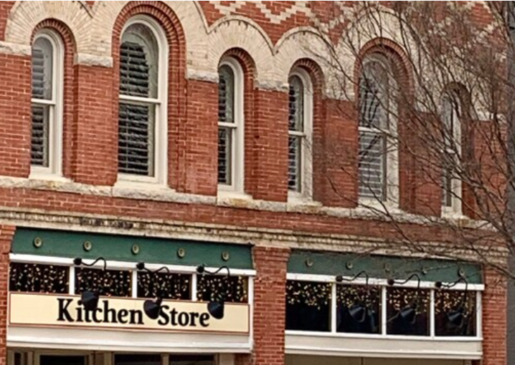
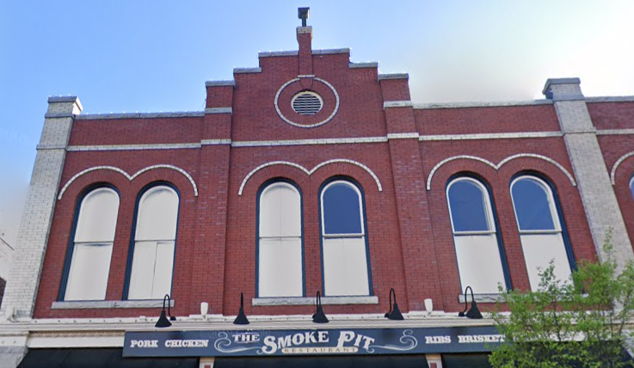
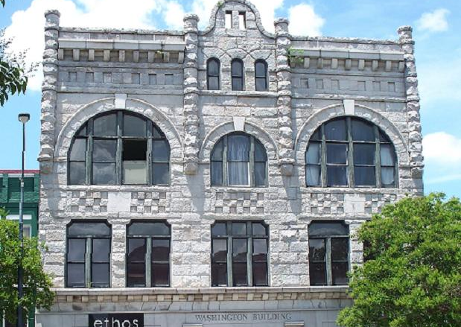
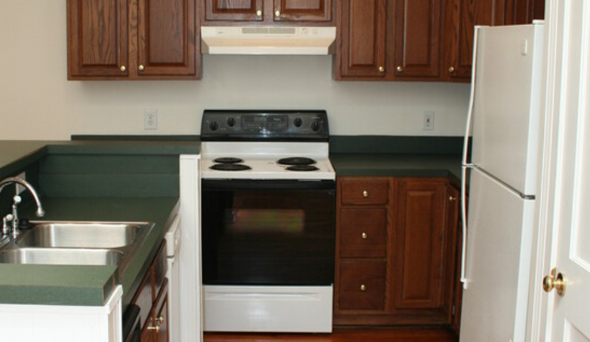
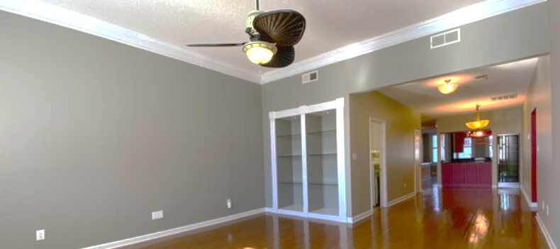
Downtown Multifamily Commands Higher Rents
The Kitchen Store
2 BR: 1757 SF at $1685 ($0.96 PSF)
The Smoke Pit
2 BR: 1250 SF at $1385 ($1.11 PSF)
Washington Building
1 BR: 810 SF at $1100 ($1.36 PSF)
2 BR: 832 SF at $1200 ($1.44 PSF)
106 N. Main St.
113 E. Innes St. Unit 113
118 N. Main St. Units 301-305
SOURCES: DFI Interviews and Analysis

Slide 30
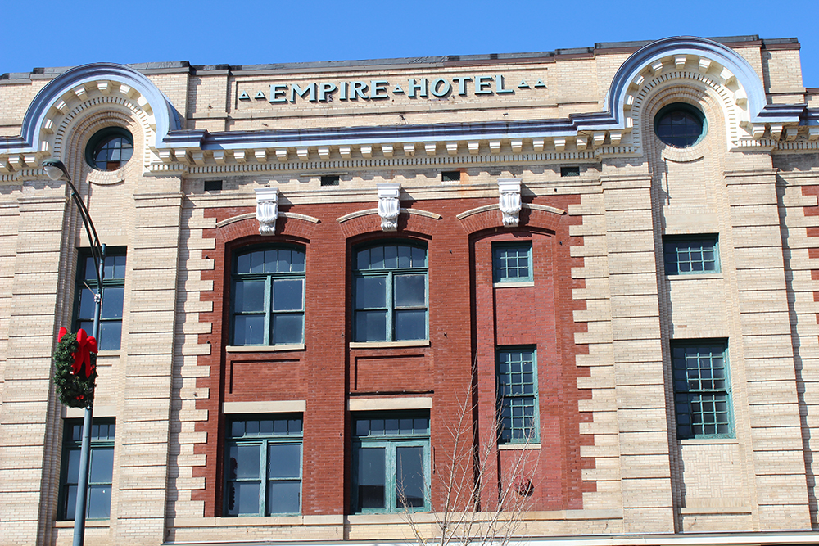
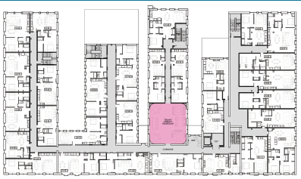
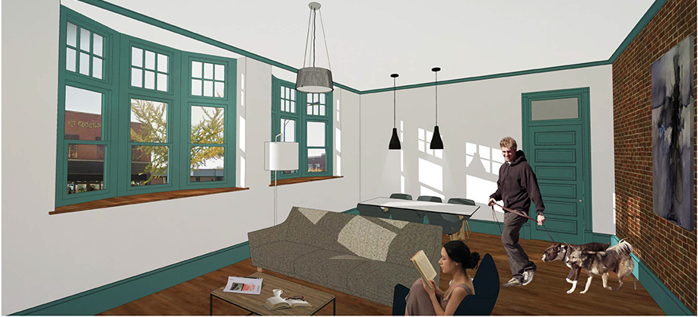
Spotlight: Empire Hotel 212-228 S. Main St.
Est. Completion: Winter 2022
104K+ SF
62 +/- market rate apartments
Live/work, co-work/flex spaces
By adding ~50% more residential downtown, the Empire Hotel will test absorption and rents
SOURCES: DFI Interviews and Analysis

Slide 31
COVID-19 Impact on Multifamily
Multifamily leasing levels-maintained stability for first portion of pandemic but have decreased in last month. (CoStar)
16% of NC renters didn’t pay rent in July with additional 7% deferring rent (US Census)
Estimated 25% of NC renters have little to no confidence on making August rent payment (US Census)
Federal eviction moratorium expired in July with lack of rental assistance program.
Expiration of expanded federal unemployment benefits also raises concerns over renters ability to pay upcoming rent.
Severe downside projections for Rowan county show a 6.5% vacancy rate, which is closer to a stabilized vacancy rate.
SOURCES: CoStar, DFI Interviews and Analysis, US Census Bureau Survey

Slide 32
Multifamily Market Summary
New product close to downtown is limited.
Downtown product commands avg rents of $1.21 PSF and is staying occupied.
Potential multifamily demand for the City of Salisbury is 400 – 575 units over the next five years.
Potential demand for Downtown Salisbury is ~125 units.
Empire hotel will test downtown absorption and rents, adding ~50% more product downtown.
Impact of the expiration of both the eviction moratorium and pandemic unemployment benefit still to be seen.

Slide 33
Hospitality

Slide 34
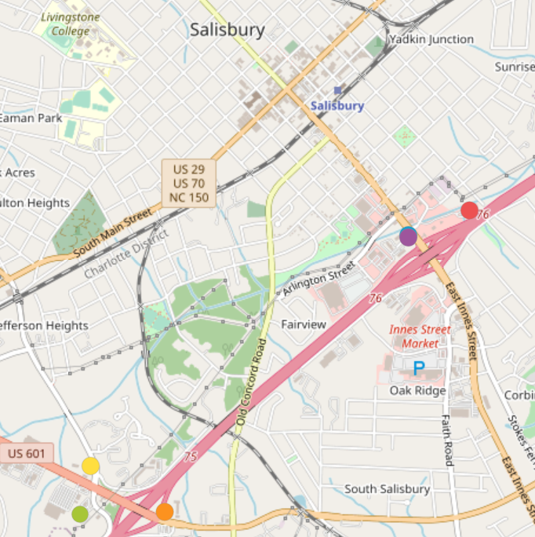
Salisbury Hospitality Trade Area
6
528
Hotels Surveyed
Total Rooms
Along I-85 in Salisbury
Average rooms per hotel: 94
Midscale to Upscale
74%
Hotel Class
Occupancy Rate
All classified as chain hotels
Pre-COVID-19 (2019)
2005
$108
Average Open Date
Average Daily Rate
Newest: 2019
Oldest: 1991
Pre-COVID-19 (2019)
SOURCES: STR, ESRI

Slide 35
Smith Travel Reports and Hotel Indicators
STR reports are required by developers to initially assess local market performance indicators:
Average Daily Rate (ADR): Room revenue per rooms sold
Occupancy Rate: Percent of rooms occupied
Revenue Per Available Room (RevPar): Room revenue per all rooms
Do not include:
Details on a single hotel
Demand trends

Slide 36
Hospitality Markets Comparison
Market indicators in Salisbury have remained strong despite new product coming online in 2017 and 2019

Slide 37
Sustained Year-Round Occupancy: Jan. – Dec. 2019
Top Quarter
74% Monthly Average
65% NC Average
SOURCES: STR

Slide 38
Sustained Weekday Occupancy: April 2019 – March 2020
Tue and Wed each average 80%
SOURCES: STR

Slide 39
Downtown Demand/Feasibility Indicators
Strong market indicators - sustained year-round and mid-week occupancy
Proximity to restaurants, nightlife → walkability
Proximity to convention/civic center or performing arts center
Unique attractions – historic bldg., museums, etc.
Proximity to HWY (ability to compete with existing product)
Ability to generate ADR premium (to account for increased development costs)

Slide 40
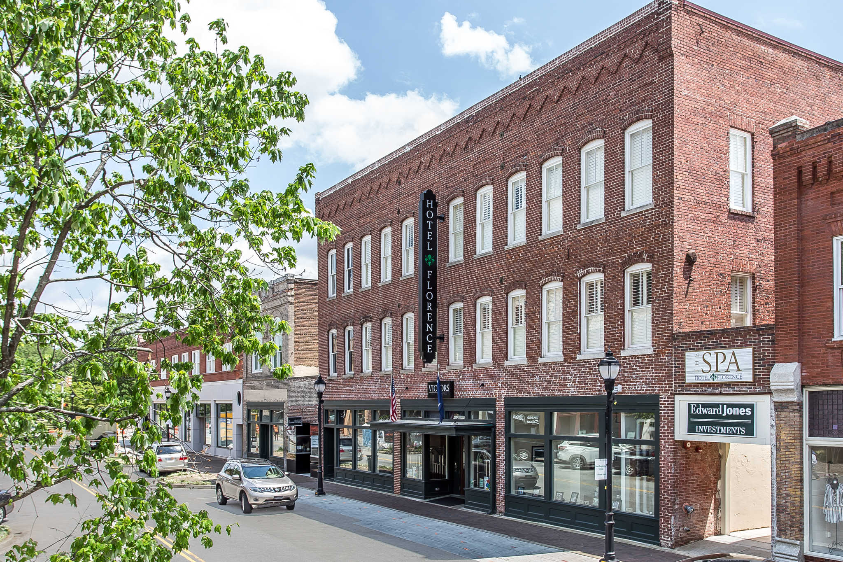
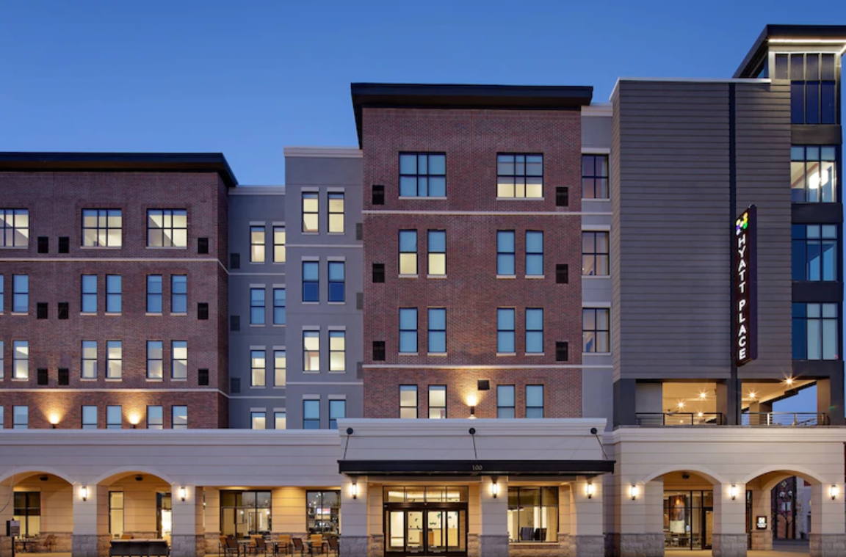
Florence SC – Downtown Hotel Success
1 hour east of Columbia, just off I-95
Pop: 38,000
Majority of hotels clustered off I-95
2 successful products downtown → 190 rooms
Downtown hotels generate up to 30% rate premium over HWY product
Hotel Florence (historic rehab - 2013)
SOURCES: DFI Interviews and Analysis
Hyatt Place Downtown Florence (2019)
40

Slide 41
COVID Impacts on Hospitality
Projected annual occupancy for 2020 is 42.6% with an estimated 37% decline in RevPAR. (CBRE)
Slow rise in demand indicates lengthy delay in return to stabilization → took over 3 years in 2008
Virus still spreading; no formal timeline for vaccine
Older, highly-leveraged supply may not survive recession
Potentially 30% decline in existing supply (interviews with hotel management firms)

Slide 42
Summary Hospitality Market Findings
100% of market supply currently clustered along I-85
2 new hotels since 2017; HWY product likely saturated
Market exhibiting strong, sustained year-round occupancy and mid-week demand
Downtown hotels in comparable markets demonstrate that CBD locations can generate significant premium above highway products
Increased costs of downtown hotels, coupled with unproven market would likely necessitate public participation
Hospitality industry will be tested over next 24 months due to COVID-19

Slide 43
Next Steps

Slide 44
Salisbury Next Steps
Continue COVID-19 analysis
Present market analysis findings to elected officials – Sep 1
DFI Site and Financial Analysis

